Slide 1
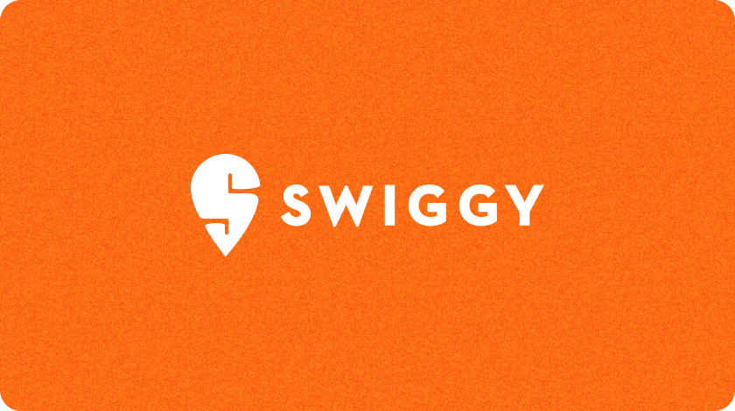

Swiggy Sales Performance Analysis: An Excel Dashboard Approach
This presentation unveils an interactive Excel dashboard designed to provide a comprehensive analysis of Swiggy's food delivery sales. Our focus areas include critical revenue trends, deep dives into customer behavior patterns, and granular insights into regional performance.

Slide 2
Problem Statement & Business Requirements
Problem Statement:
Business Requirements:
Sales data spans multiple dimensions: time, food category, and geography.
Key Performance Indicators (KPIs):
Total Sales (₹)
Manual analysis significantly limited visibility into performance and emerging trends.
Total Orders
Average Order Value (₹)
There was a critical need for a consolidated, Excel-based dashboard for effective decision support.
Average Rating
Ratings Count
Key Charts to Develop:
Sales Trends
Food Type Analysis
Monthly, Daily & Weekly
Veg vs. Non-Veg Sales
Geographic Insights
Quarterly Overview
State-wise & Top 5 Cities
Performance Summary

Slide 3
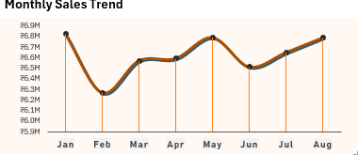
Monthly Sales Trend Analysis
Observations:
January, May, and August emerge as peak months, each generating approximately ₹6.8 Million in sales.
February records the lowest sales volume at around ₹6.3 Million.
Following February, sales steadily recover, reaching another peak in May.
A minor dip is observed in June, followed by a consistent rise towards August.
Strategic Insight:
Sales data clearly indicates a seasonal and cyclical pattern, highlighting predictable demand peaks and short-term slowdowns that can be anticipated and planned for.

Slide 4
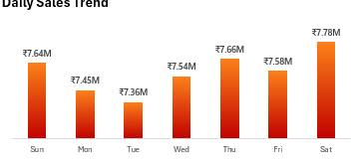
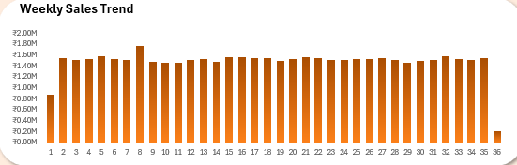
Daily & Weekly Sales Trends
Key Observations:
Saturday records the highest sales at ₹7.78 Million, signifying a significant weekend surge.
Thursday (₹7.66 Million) and Friday (₹7.58 Million) show strong pre-weekend momentum.
Sunday sales remain robust at ₹7.64 Million, extending the weekend peak.
Tuesday records the lowest sales at ₹7.36 Million, followed by Monday at ₹7.45 Million.
Week 8 records the highest sales at ₹1.76M, indicating a short-term demand spike, while Week 36 shows the lowest sales at ₹0.20M, followed by Week 1 at ₹0.88M.
Apart from these outliers, most weeks show stable sales performance, with no extreme highs or prolonged declines.
Strategic Insight:
Customer ordering behavior is predominantly weekend-driven, with demand steadily building from mid-week towards Saturday's peak. This highlights prime opportunities for weekend-specific promotions.

Slide 5
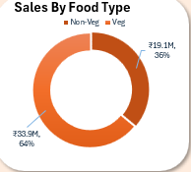
Food Type Analysis: Veg vs. Non-Veg
1
Observations:
Vegetarian category leads revenue with ₹33.9 Million, contributing approximately 64% of total sales.
Non-Veg and other categories account for the remaining share of sales.
The high revenue from Veg items indicates both frequent ordering and broad mass-market appeal.
2
Strategic Insight:
Veg items are definitively the primary revenue drivers. This suggests they are ideal for volume-based growth strategies and broad promotional campaigns.

Slide 6
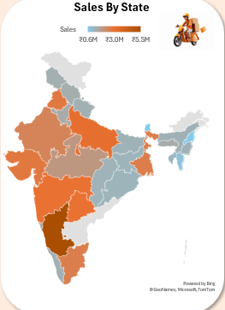
State-Wise Sales Distribution
Key Observations:
Karnataka leads significantly with ₹5.5 Million in sales, showcasing strong market penetration.
Uttar Pradesh follows with a substantial ₹3.1 Million in revenue.
Maharashtra and Telangana each contribute around ₹3.0 Million.
Nagaland and Sikkim record the lowest sales, both at approximately ₹0.6 Million.
Strategic Insight:
Revenue is heavily concentrated in a few high-performing states, indicating significant untapped potential and expansion opportunities in low-performing regions.

Slide 7

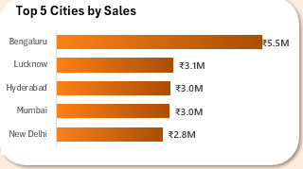

Top 5 Cities by Sales Performance
Observations:
Metro cities consistently dominate overall sales contribution.
Bengaluru unequivocally ranks as the top-performing city in terms of sales volume.
This is followed closely by Hyderabad, Mumbai, Chennai, and Delhi, forming a strong urban core.
Strategic Insight:
Urban centers serve as core revenue hubs, driven by higher population density, increased digital adoption, and diverse culinary demands. These cities are critical for sustained growth.

Slide 8
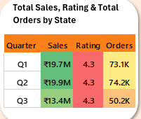
Quarterly Performance Analysis
Key Observations:
Q1 and Q2 consistently show strong sales and order volumes, indicating a robust start to the year.
1
Q3 experiences a notable decline in order volumes, suggesting seasonal shifts or external factors.
Crucially, customer ratings remain stable and high across all quarters, unaffected by order fluctuations.
Strategic Insight:
2
Fluctuations in order volume are primarily season-driven and not indicative of any underlying issues with service quality or customer satisfaction, which remains consistently high.

Slide 9



Customer Satisfaction & Order Value
Observations:
Strategic Insight:
Average customer rating remains consistently high at ~4.3, reflecting strong service perception.
Swiggy successfully maintains strong customer satisfaction and consistent spending behavior, which are critical factors supporting long-term customer retention and loyalty.
The substantial ratings count indicates robust customer engagement and feedback.
Average Order Value (AOV) maintains stability over time, suggesting consistent spending patterns per order.

Slide 10

Overall Insights & Strategic Recommendations
Overall Insights:
Key Recommendations:
Sales exhibit clear seasonality, with distinct peaks in January, May, and August.
Targeted Promotions
Demand is heavily weekend-centric, with Saturdays being the highest performing day.
Align promotions with peak months and weekends to maximize ROI.
The Veg category overwhelmingly dominates revenue, driven by high order frequency.
Veg-Centric Growth
Revenue is concentrated in metro cities and a few high-performing states.
Utilize Veg combo offers and pricing strategies to drive volume growth.
Customer satisfaction remains consistently high despite observed demand fluctuations.
Boost AOV
Leverage Non-Veg items to improve Average Order Value through premium offerings.
Expand Reach
Implement targeted marketing and partnerships in low-performing states.
Optimize Capacity
Ensure optimal delivery capacity from Thursday to Sunday to handle peak demand efficiently.

